Slide 1
Potato Chip Mailing Contest
Group #4

Slide 2
Objective/Requirements
Build a container so that a Pringles potato chip can be mailed with as little damage to it as possible.

Slide 3
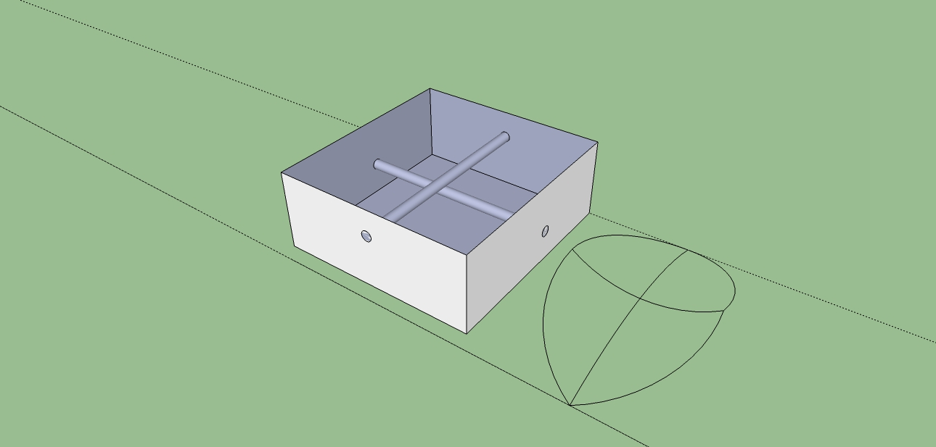
Design
Put CAD picture here of your design
Height 2.5cm, Width 5cm, Base 7.5cm
Pieces that span the width and base in the box

Slide 4
Predicted Score with Explanation
17.77
We estimate slight breakage so we would earn 50 point for chips and we guessed that our design would weigh approximately 30 grams and the volume would be about 93.75 cubic cm. So 17.77 is what we got when we plugged in all the numbers.

Slide 5
Parts List
Cardboard
Wood Clue
Feeling zesty? Use cotton balls as well.

Slide 6
Photo of Mailed Container

Slide 7
Data
Official Score

Slide 8
Lessons Learned
What worked well
What would you change next time
If your predicted score differed from your actual, why?

